Slide 1

Error Analysis
Build your first system
quickly, then iterate
deeplearning.ai

Slide 2
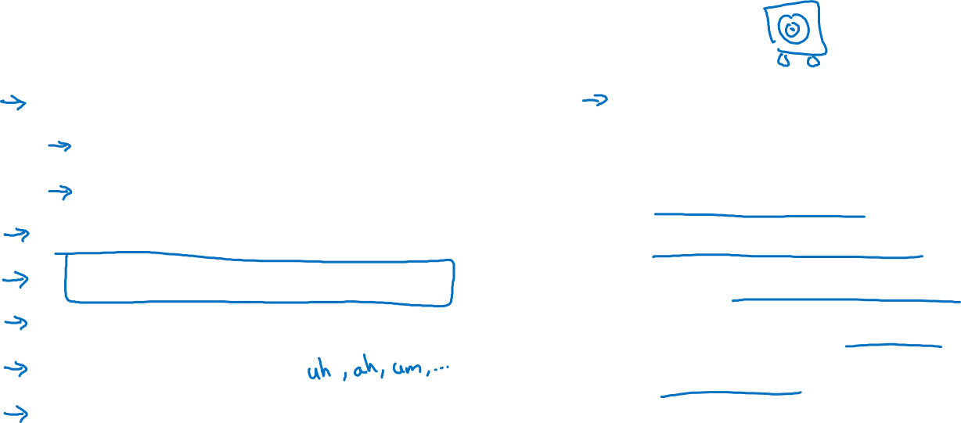
Speech recognition example
Noisy background
Café noise
Car noise
Accented speech
Far from microphone
Young children’s speech
Stuttering
…
Set up dev/test set and metric
Build initial system quickly
Use Bias/Variance analysis & Error analysis to prioritize next steps.
Guideline:
Build your first system quickly, then iterate

